Slide 1
Job For All
Presented By,
RIFAT AL MAMUN RUDRO(19-39909-1)
MD. HAMID UDDIN(19-40250-1)
TANU SREE ROY TAMA(19-40503-1)
MD. JISUN ABEDIN AURNOB(19-40318-1)

Slide 2
Introduction
Purpose: To Make The Connection Between Employee & Employer Easily
User: All Sorts Of User Who Wants To Give Job Or Who Needs Job
Special Feature: All Sorts Of Valid Jobs Can Be Posted
Problem Solution: It Helps To Reduce Unemployment Problem

Slide 3
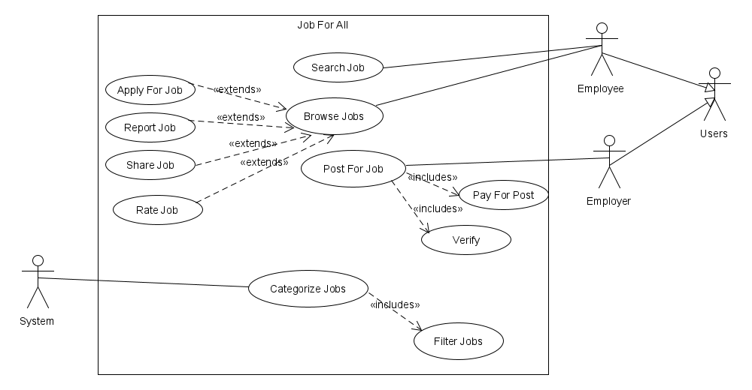
UML Use Case Diagram

Slide 4
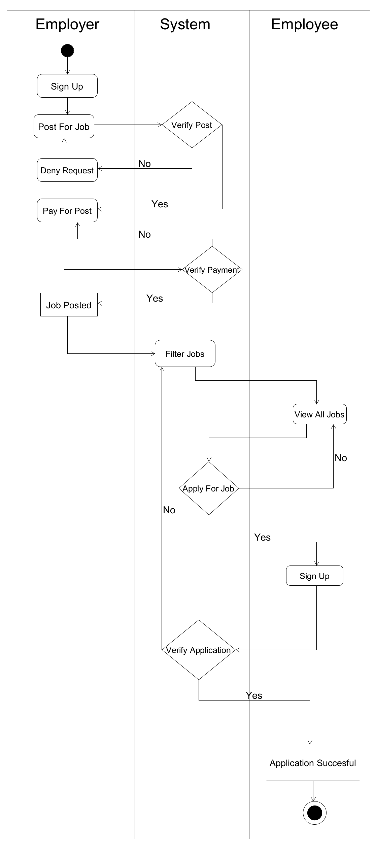
Activity Diagram

Slide 5
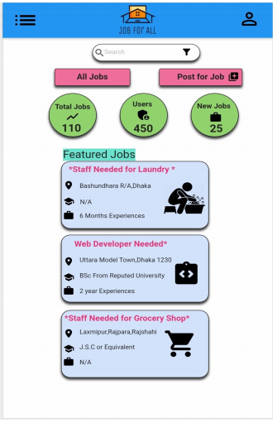
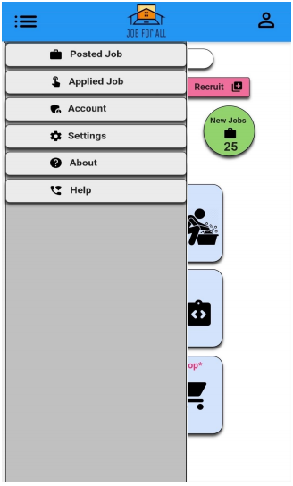
Mock Design

Slide 6
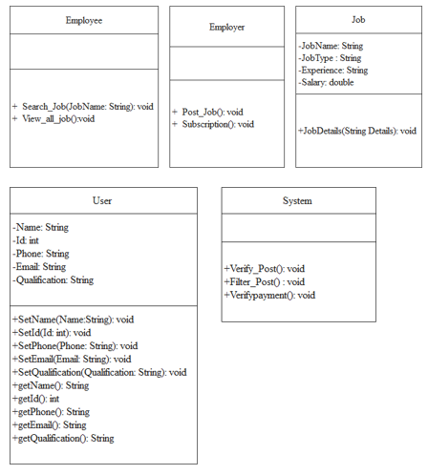
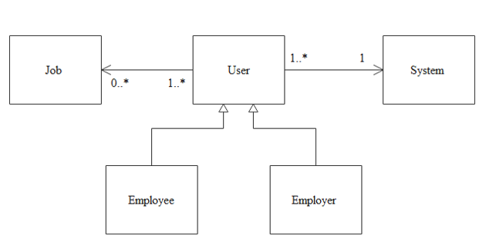
Class Diagram
ER Model

Slide 7
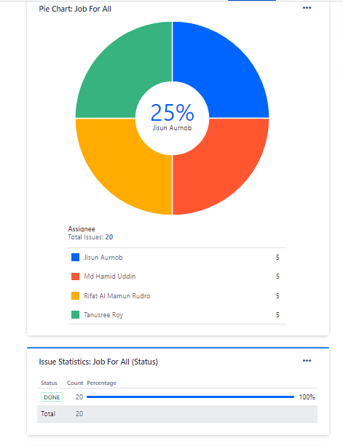
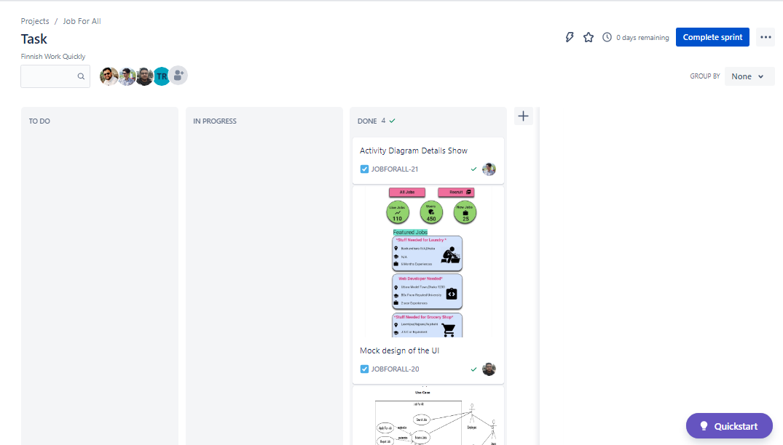
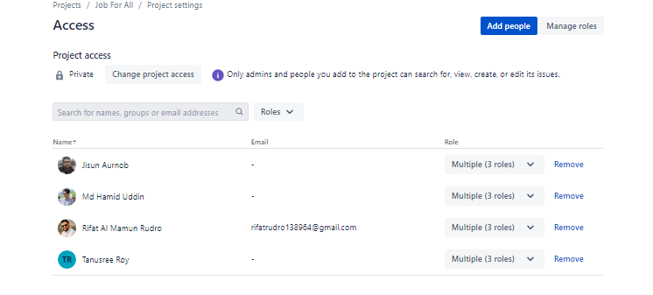
JIRA

Slide 8
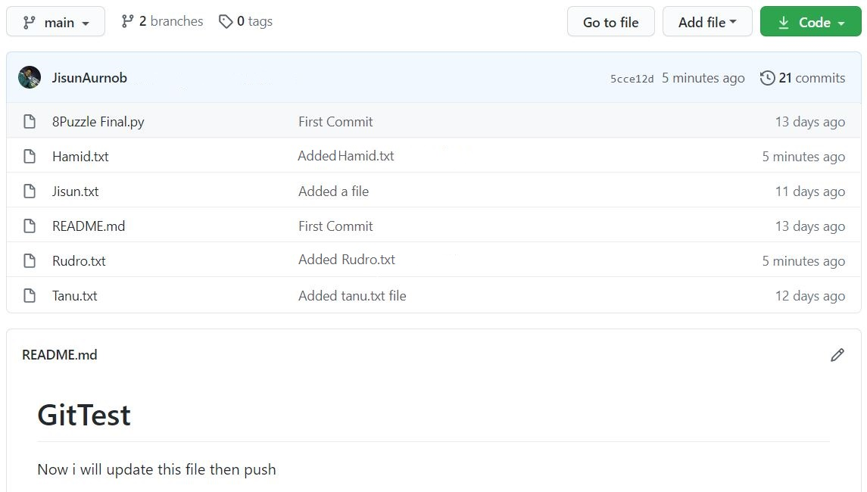
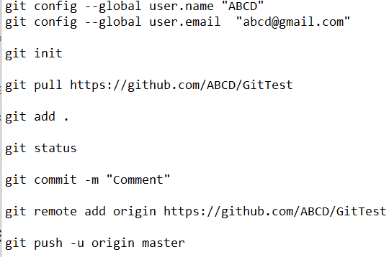

Git

Slide 9
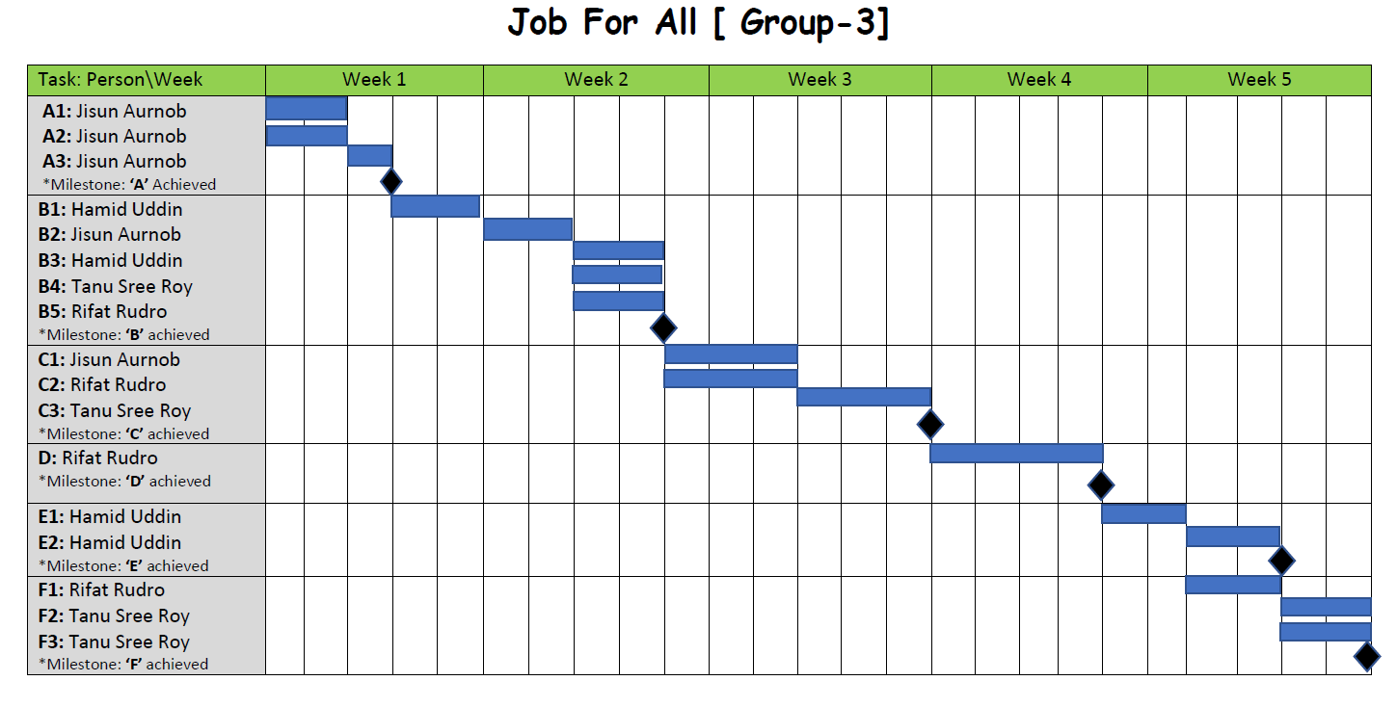
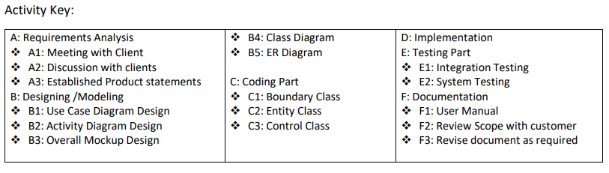
Project Scheduling

Slide 10
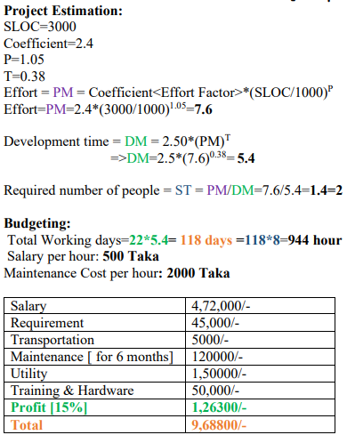
Project Budgeting (COCOMO MODEL)

Slide 11
Conclusion
To Reduce The Unemployment Problem & Also To Generate Revenue From This Application, The Project Has Been Selected
Before Starting The Development Part, Some UML Diagrams, Mock Design, Class Diagrams, ER Model, Project Scheduling & Budgeting Has Been Done
By Using Umlet, Diagrams Has Been Developed, Using mockups.com Developed The Mock Design
To Develop The Project Fluently JIRA & GIT Has Been Used

Slide 12


